Slide 1
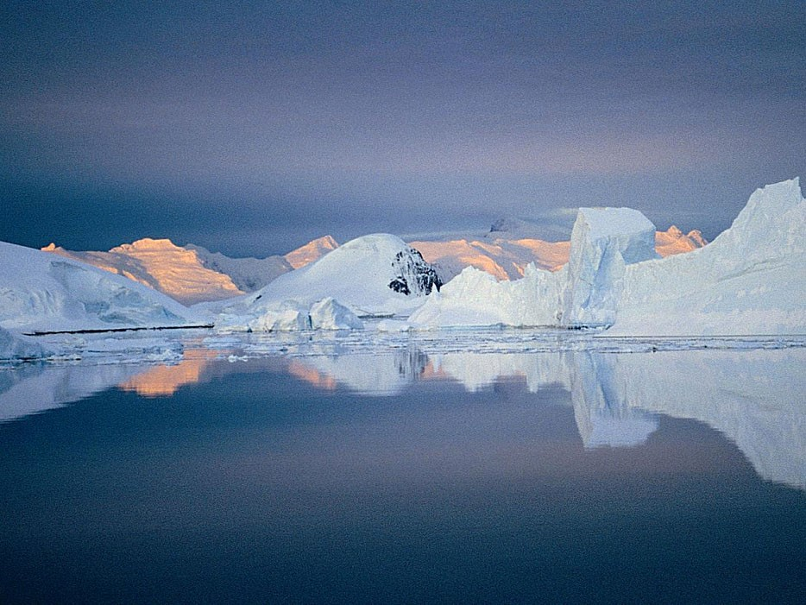
Monitoring and Foreseeing the Changes: The Role of Earth Observations
Monitoring the Polar Regions
Roberto Azzolini
National Research Council of Italy

Slide 2
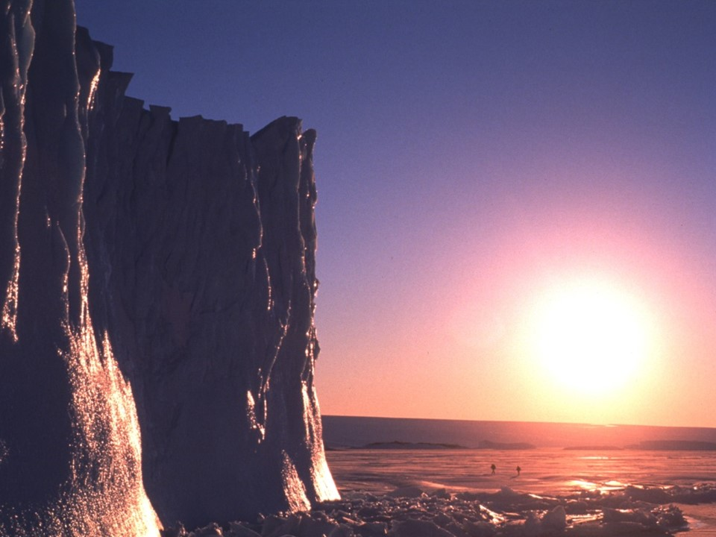
Why monitoring the Poles ?
The Poles
The heart of the Earth
Notes:
2

Slide 3
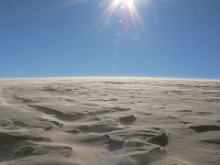
The polar frozen surfaces reflect a significant part of the solar radiation and cool the ocean waters flowing from the equator; in this way they contribute to the Earth climate and to the equilibrium of the temperature on the planet

Slide 4
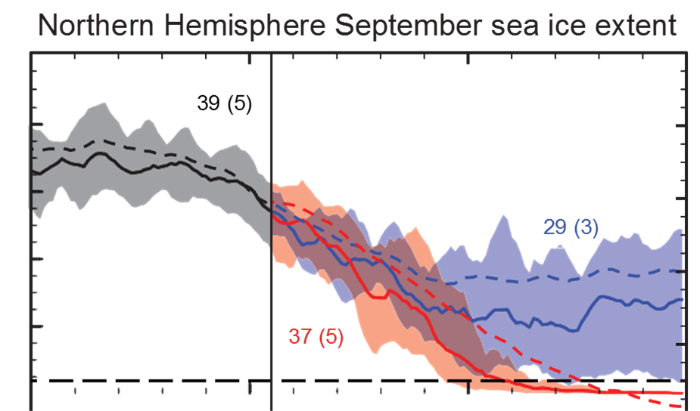
Disappearing of the Arctic Ice in Summer is expected in one or few human generations
Such a dramatic physical affront to the Arctic Ocean-Ice-Atmosphere system, corresponding to a change in surface albedo from more than 0.8 to less than 0.3 over a surface larger than Europe, is bound to have radical effects on human activities with immediate impacts on indigenous inhabitants and circum-Arctic regions and the ecosystems on which they depend, and with widespread effects on socio-economic activities on hemisphere scale (AOSB-Clic Plan for IAOOS version 4)

Slide 5
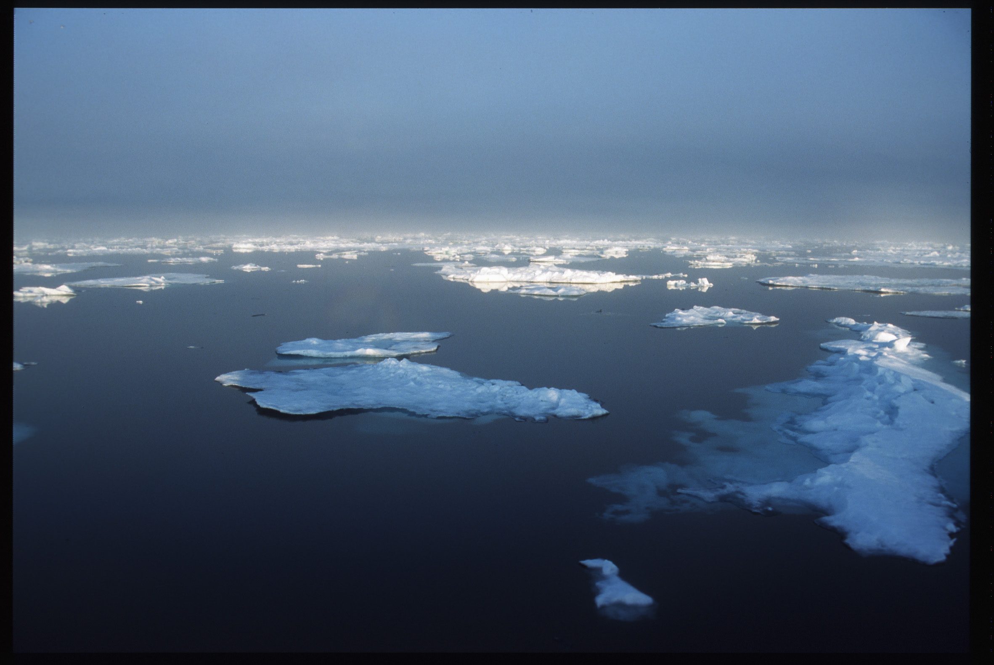

The polar oceans are key areas of exchange of atmospheric gases; temperature changes in these regions may alter the concentration of CO2 in the atmosphere and affect the global climate

Slide 6
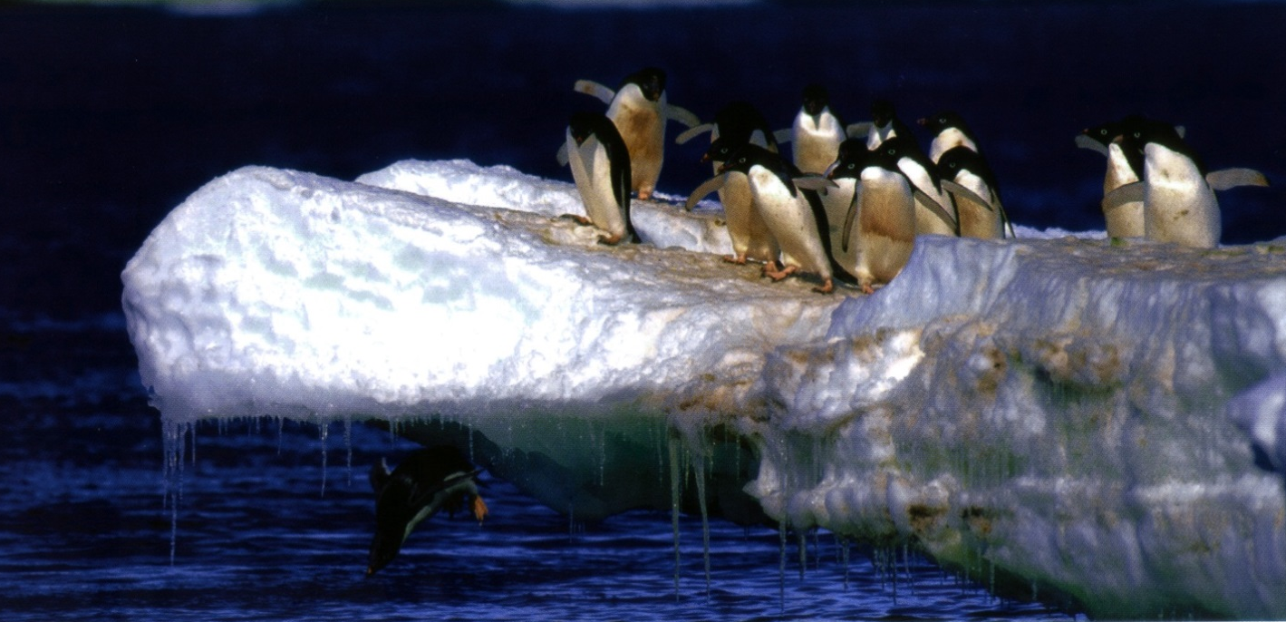
The sea ice is a container in which a complex food-chain preserves life in the oceans during the long polar winter and support the upper level of trophic chain.
Ocean acidification has the potential to inhibit embryo development and shell formation of some zooplankton and krill in the polar regions, with potentially far-reaching consequences to food webs in these regions. Embryos of Antarctic krill have been shown to be vulnerable to increased concentrations of carbon dioxide (CO2) in the water. (Source, IPCC Report, Cap. 28)

Slide 7
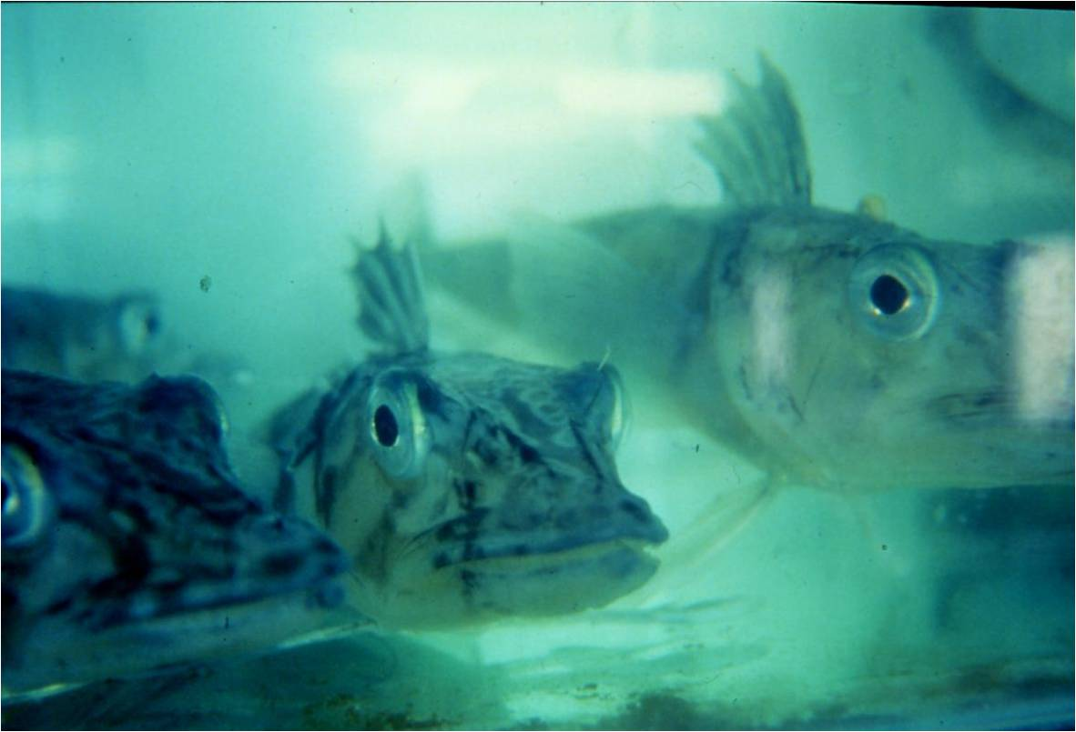
The Antarctic frozen and isolated environment has forced the living organisms to adopt proper strategies of adaptation to the extremely low temperatures; doing so, they reveal the genetic, physiological, biochemical and molecular mechanisms governing the adaptation and evolution of the species.
Icefish (Chionodraco hamatus, fam. Channichthyidae)

Slide 8
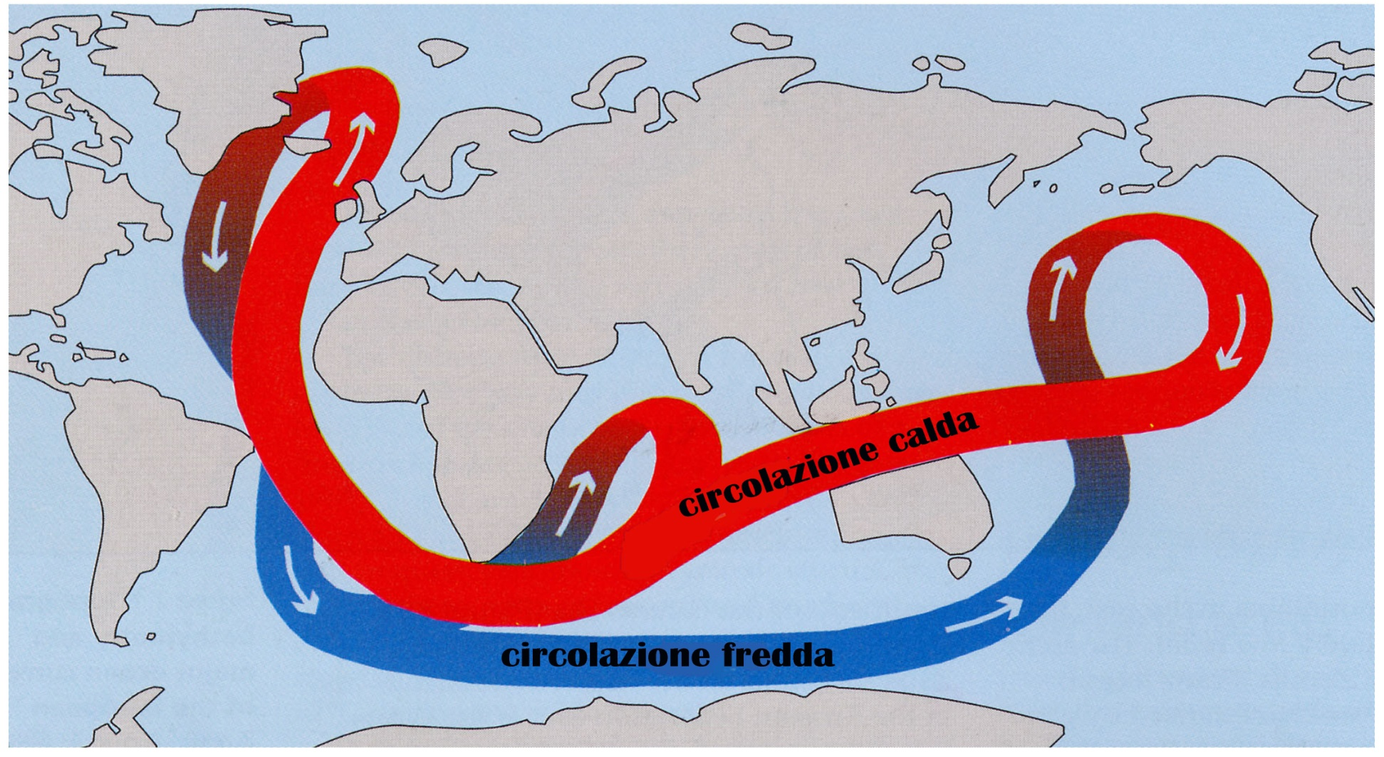
The Arctic regions produce cold waters that sink in the ocean floor attracting warmer surface waters from the lower latitudes. Cold polar waters absorb a huge amount of CO2 and transport it to the bottom of the ocean where it remains buried for centuries. This mechanism is crucial for distributing the heat and limiting the excess of this greenhouse gas in the atmosphere

Slide 9
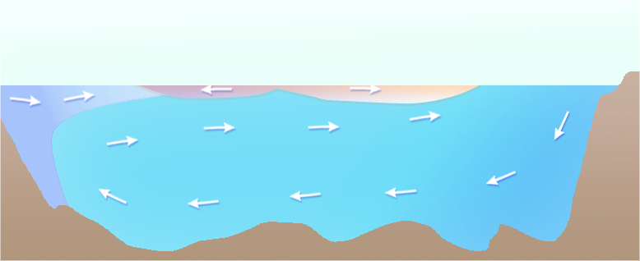
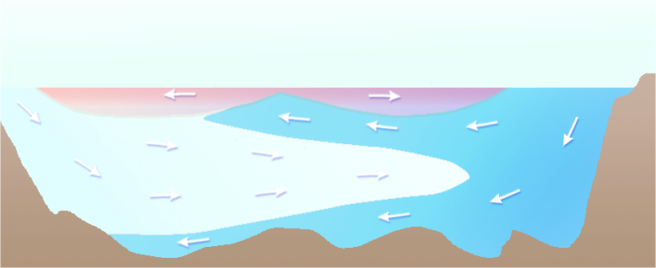
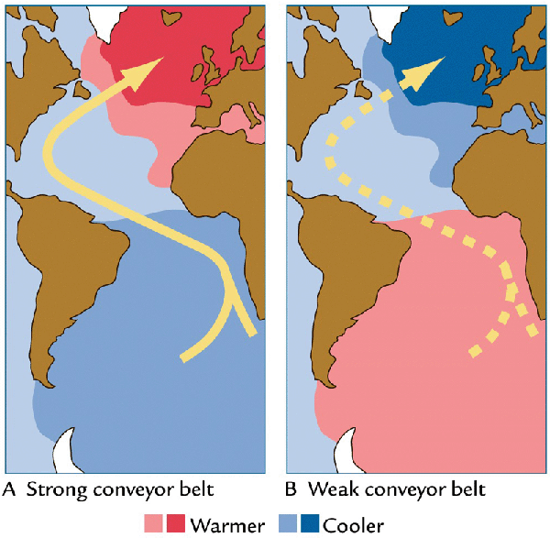
Atlantic Meridional Overturning Circulation (AMOC) collapse
m
North Atlantic
Equator
South Atlantic
Antarctica
Gulf Stream
North Atlantic Current
Deep Antarctic Current
Corrente profonda
antartica
60°N
30°N
0°
30°S
60°S

Slide 10
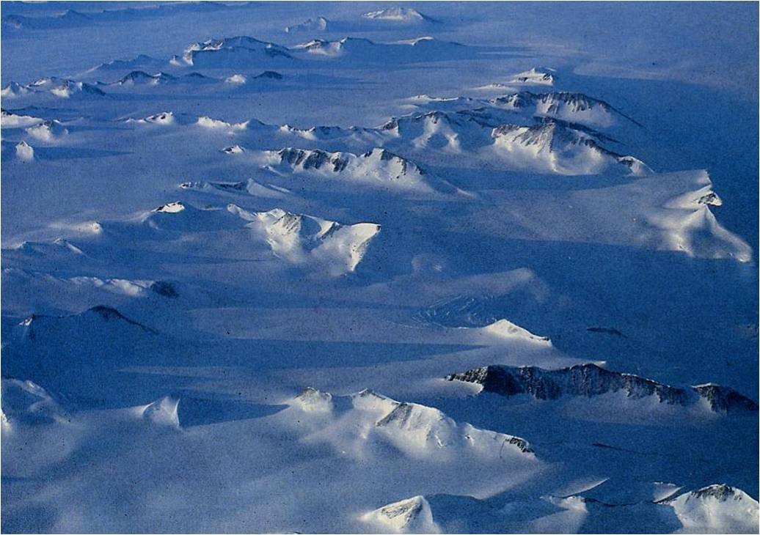
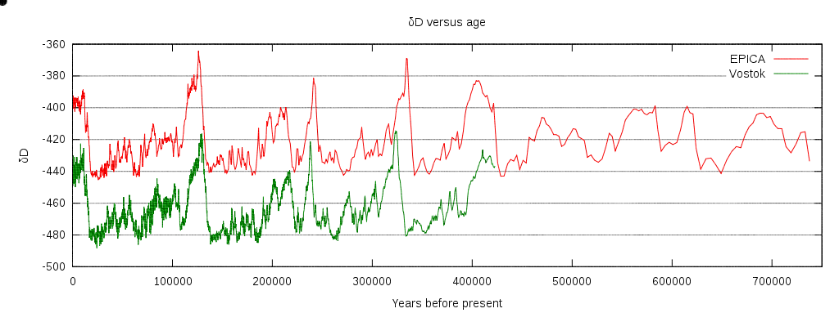
The ice of the Polar Regions is the archive of the history of our planet

Slide 11


Slide 12
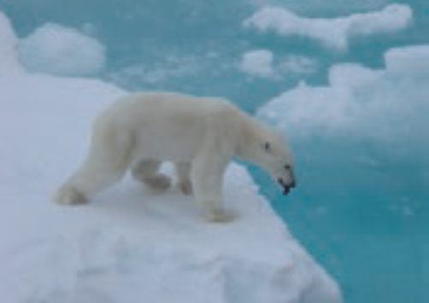
POLAR CHANGES GLOBAL CONSEQUENCES

Slide 13
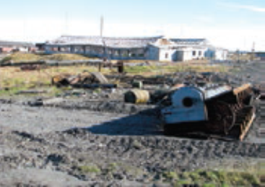
POLAR CHANGES, GLOBAL CONSEQUENCES
Decreasing summer sea-ice extent leads to more solar energy being captured by open water in an accelerating feedback process. It also leads to less temperature differential between high and mid latitudes affecting the jet stream and resulting in changing weather patterns that can strongly impact lower latitudes causing damage to property and infrastructures, loss of agricultural production, transport disruption, and health issues.
Melting of ice sheets and glaciers in both Polar Regions is raising global sea-levels, with severe consequences for coastal communities, also amplified by subsidence processes. The continental ice of Greenland could be affected and melt rising the sea level of several meters. The climate of the planet would be strongly affected.
Summer thawing of Arctic permafrost has seen increasing release of the greenhouse gases methane and carbon dioxide from both land and shallow shelf seas. Thawing permafrost may significantly affect land based transport and building infrastructure, whilst loss of Arctic marine methane (gas hydrate) from sediments could initiate underwater landslides generating possible tsunami threats for Europe.

Slide 14

POLAR CHANGES, GLOBAL CONSEQUENCES
The Southern and Arctic Oceans are warming and becoming more acidified. Such changes could make these oceans sources of, rather than sinks for, greenhouse gases, significantly impacting the global carbon cycle. Acidification will affect marine food chains and ecosystems with important consequences for polar biodiversity, commercial fisheries and indigenous societies.
Ecological processes will be affected by Climate variability in a multitude of ways. New polar marine species will colonize polar ecosystems at a faster rate than in other regions of the globe. Changing dynamics of polar marine ecosystems may have substantial implications for fishery and for critical food web components such as krill and other polar species included polar bear.
Black carbon is a short-life anthropogenic climate forcer (SLCF) contributing to Arctic atmospheric haze and a significant Arctic pollution and health issue. It also decreases the albedo of snow and ice, and so accelerates melt.

Slide 15
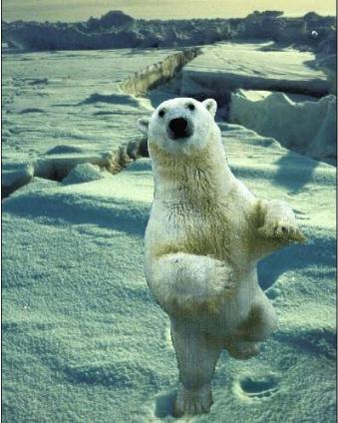
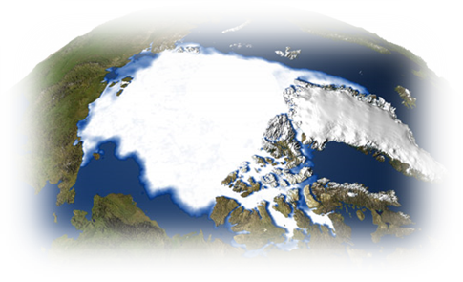
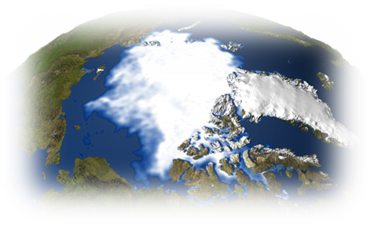
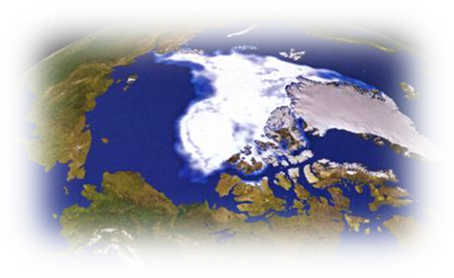
The current question is no longer “if” but “when” and how intensively these events will occur?
Monitoring and understanding Polar oceans, ice caps and Polar environment may provide answers on the future of our planet.
They help us:
Disclose the past changes
Monitor the current changes
Predict future scenarios

Slide 16
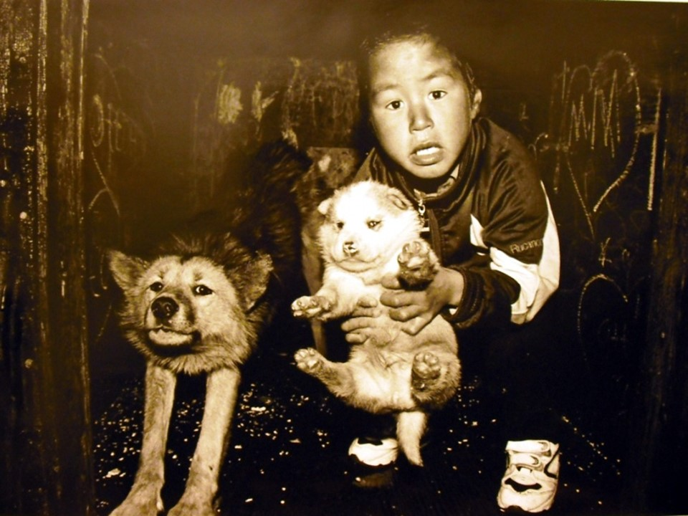
POLICY AND COOPERATION IN POLAR REGIONS

Slide 17
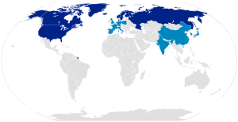


ARCTIC COUNCIL
Established in 1996 (after AEPS, 1991)
promoting cooperation, coordination, and interaction among the Arctic States, with the involvement of the Arctic Indigenous communities and other Arctic inhabitants on sustainable development and environmental protection
8 Arctic Countries + 12 Permanent Observers Countries + 6 Arctic indigenous communities + non-governmental observers
6 Working Groups on strategic issues (included AMAP)
Scientific Advisor: International Arctic Science Committee, IASC (1990)
Arctic Operation: Forum of Arctic Research Operators (FARO)
Notes:
17

Slide 18

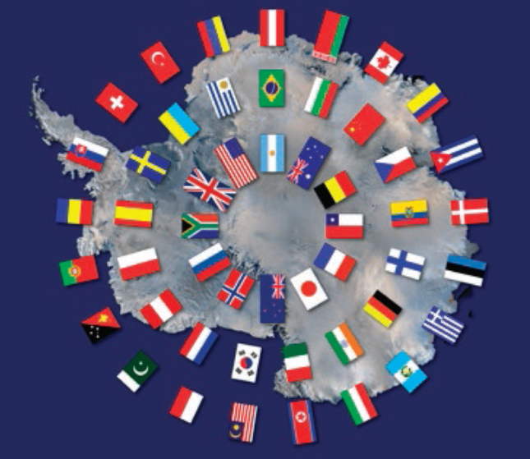

ANTARCTIC TREATY SYSTEM
Antarctic Treaty – signed 1959 – ratified 1961
51 Countries - 29 Consultative Status
Frozen claims among signatory Parties
Antarctica, land of peace and science
Cooperation/information, mandatory
Data management through SC-ADM
Protocol for Environmental Protection (Madrid 1991)
Convention on the Conservation of Antarctic Marine living Resources (CCAMLR, 1982)
Convention for the Conservation of Antarctic Seals (CCAS, 1972)
Scientific Advisor: Scientific Committee on Antarctic Research (SCAR)
Antarctic Operation: Council of Managers of National Antarctic Programs (COMNAP)

Slide 19
GALWAY STATEMENT ON ATLANTIC OCEAN COOPERATION
The Galway Statement on Atlantic Ocean Cooperation was issued in Galway, Ireland, on 23-24 May 2013.
It focuses on the Atlantic as a shared international resource and provides an appropriate high-level policy framework for improving international research cooperation across the Atlantic Ocean and into the southern Arctic Ocean.
The Galway statement looks at the preservation of the Ocean and promotes the sustainable management of its resources.
It recognizes that improving and aligning observations, coordination of data sharing, interoperability and observing infrastructures is fundamental to understanding the ocean and forecasting its future.

Slide 20
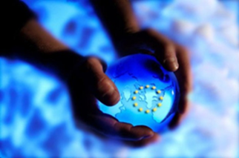
EUROPE STRATEGY IN MONITORING THE POLES
COUNCIL OF EUROPEAN UNION
Council conclusions on developing a European Union Policy towards the Arctic Region – March 2014
A better understanding of the developments underway in the Arctic is vital to ensure a sustainable future for the region and its peoples. The Council therefore supports an enhanced contribution by the EU to Arctic research, including monitoring and observation efforts, and to the sharing and dissemination of information about the Arctic. ……. The Council stresses the importance of the alignment of Arctic research programs in the EU in dialogue with other partners active in Arctic research.
The Galway statement on Atlantic and Arctic Ocean research cooperation between the EU, the United States and Canada of 24 May 2013 is a further step in this direction.

Slide 21
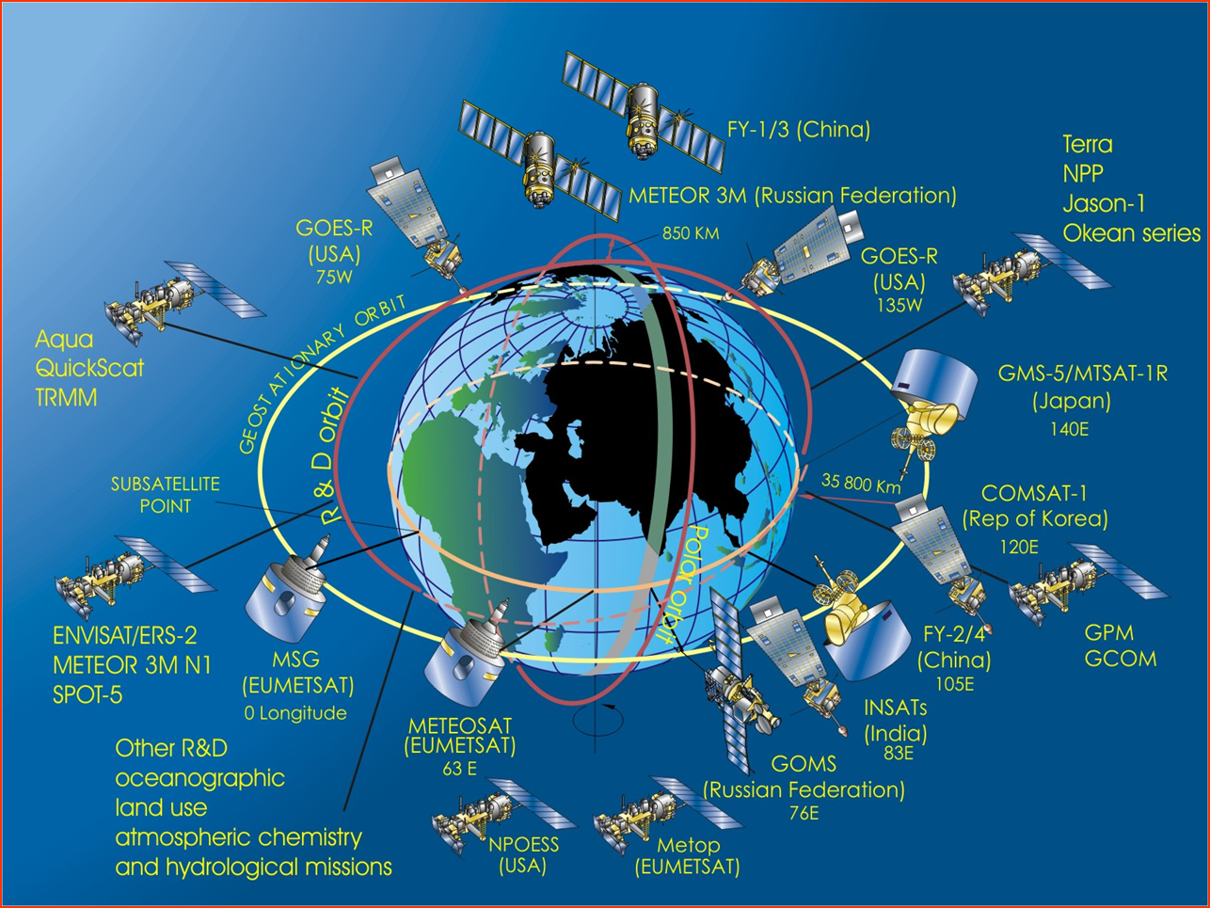
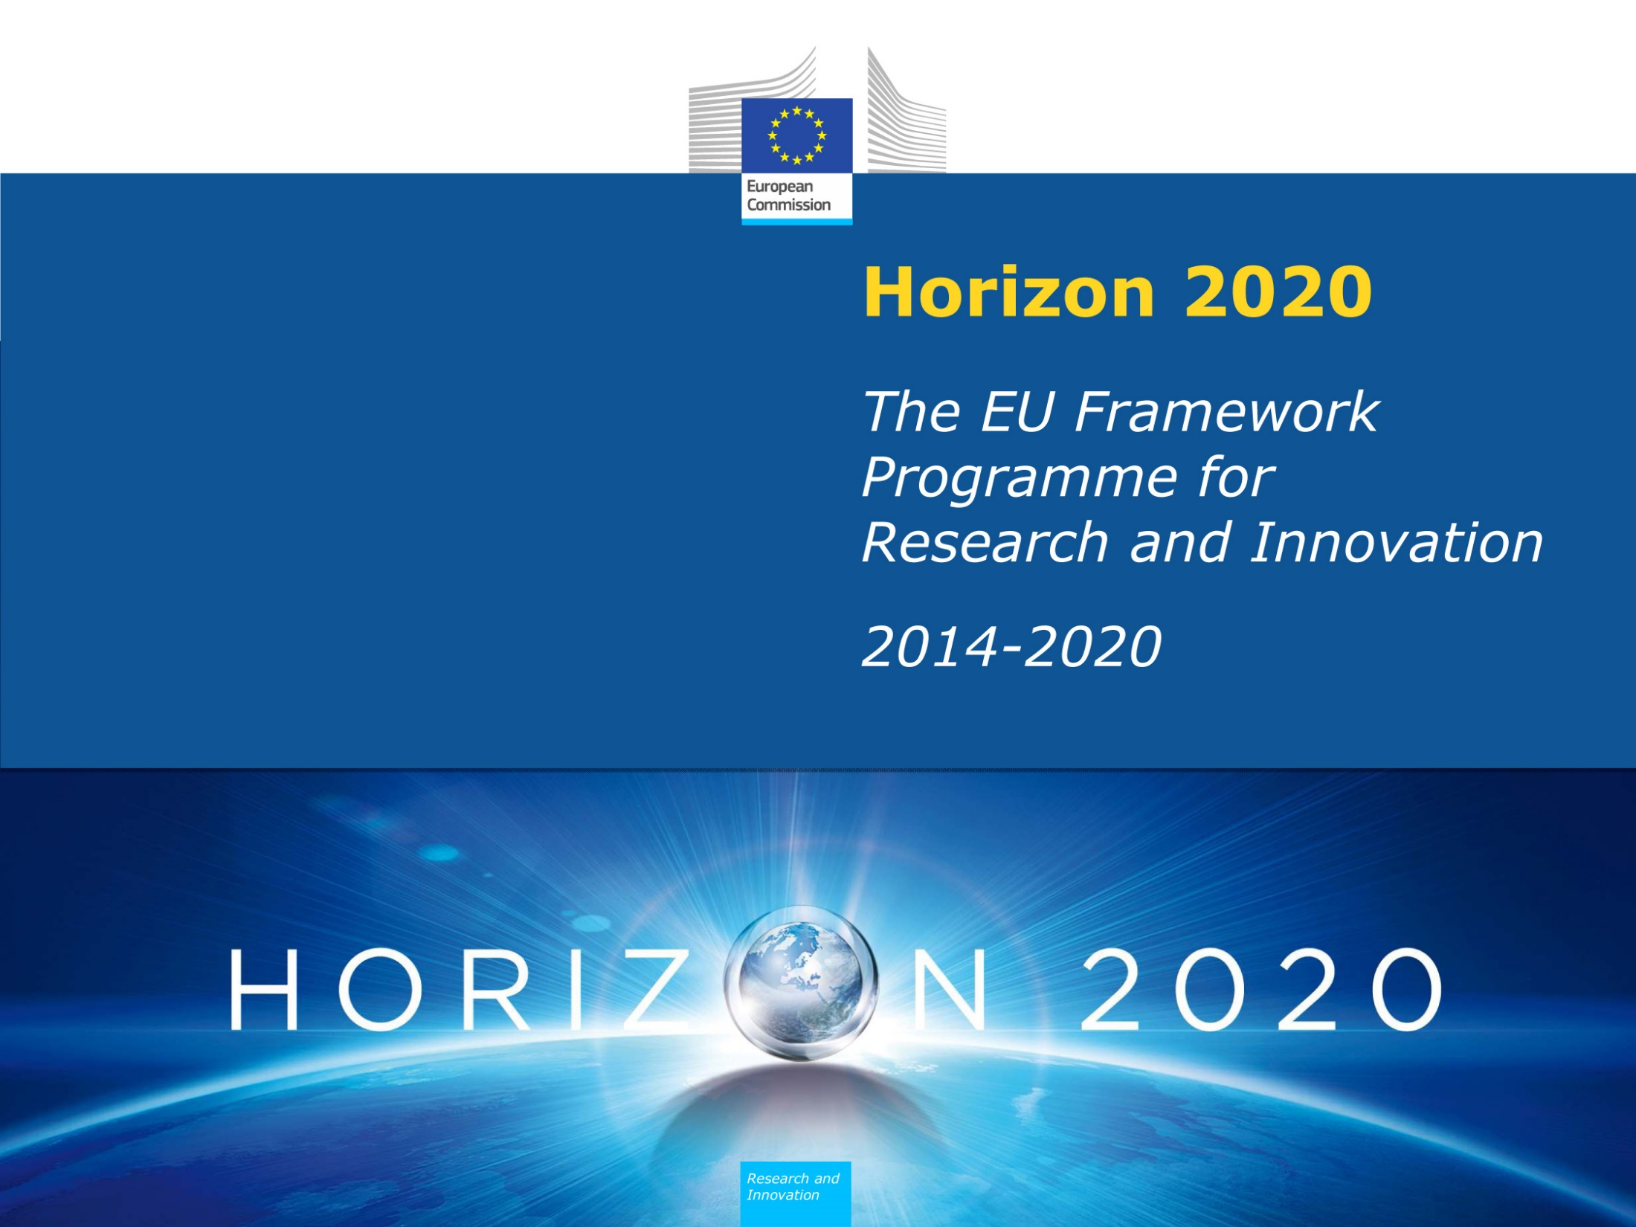
SATELLITES CONSTELLATION IN 2009
Courtesy of David Hik

Slide 22
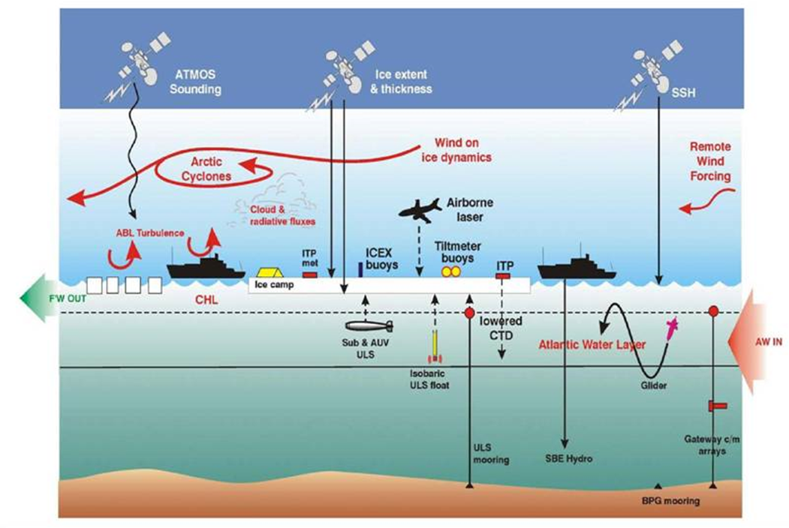
Call for Blue Growth: unlocking the potential of Seas and Oceans (Pillar: Tackling Societal Science; Area: Food Security, Sustainable Agriculture and Forestry, Marine, Maritime and Inland Water Research and the Bioeconomy)
The Call for Blue Growth Call is the main area offering opportunities to develop research linked to polar and circum-polar life, climate and environment.
The 'Blue Growth' Focus Area is supporting the new Atlantic Ocean Cooperation Research Alliance launched by the Galway Statement in May 2013.
iAOOS, courtesy of NPI

Slide 23
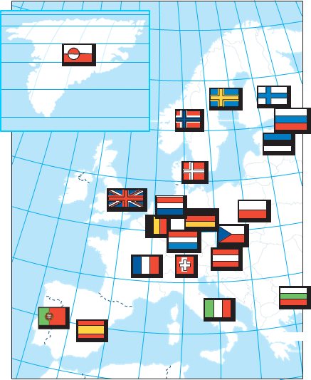
In the framework, the European Commission funded the 5 years European Polar Board application EU/Polarnet – Connecting Science with Society.
EU-PolarNET aims to develop an Integrated European Polar Research Programme that will conduct societally-important, science and observations in both polar regions over the next few decades.
Other relevant supported actions within Horizon 2020 are:
Integrated Atlantic Ocean Observing System (IAOOS); interoperable exchange of Atlantic ocean observation as promoted through GEO.
New generation of advanced and well-evaluated global climate and Earth-system models and related prediction systems
Strengthening European participation within Global Earth Observation (GEO) and Global Earth Observation System of Systems (GEOSS)
Collection and availability of Earth Observation data and information.

Slide 24
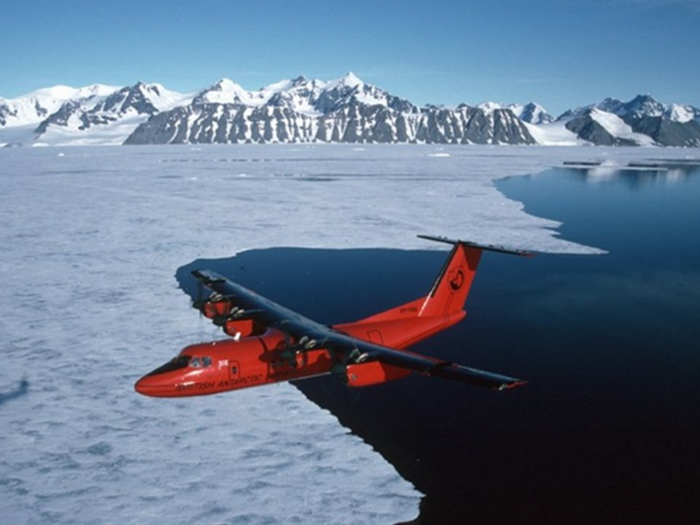
INFRASTRUCTURE AND NETWORKS FOR POLAR OBSERVATIONS AND MONITORING

Slide 25
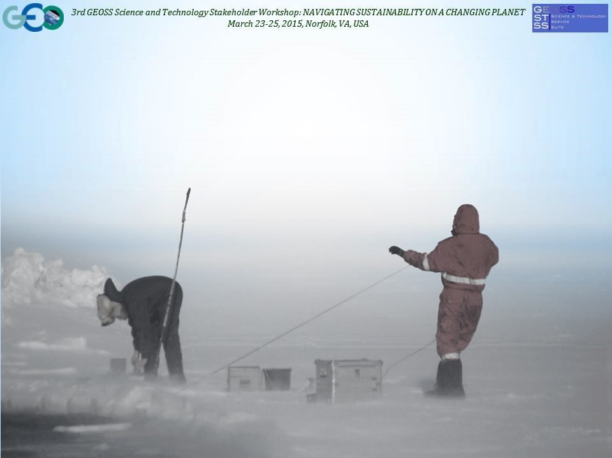
SCIENTIFIC COOPERATION IN POLAR REGIONS
Societal Needs
Scientific questions
Rationale and analytical Model
Observation targets and methodologies
Improving science/model
UNDERSTANDING POLAR REGIONS
Verification and improvement
Observation networks
Delivery
Predictions/Scenarios
Delivery
Predictions/Scenarios

Slide 26
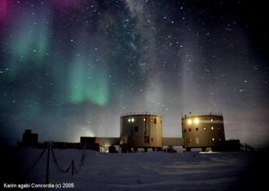
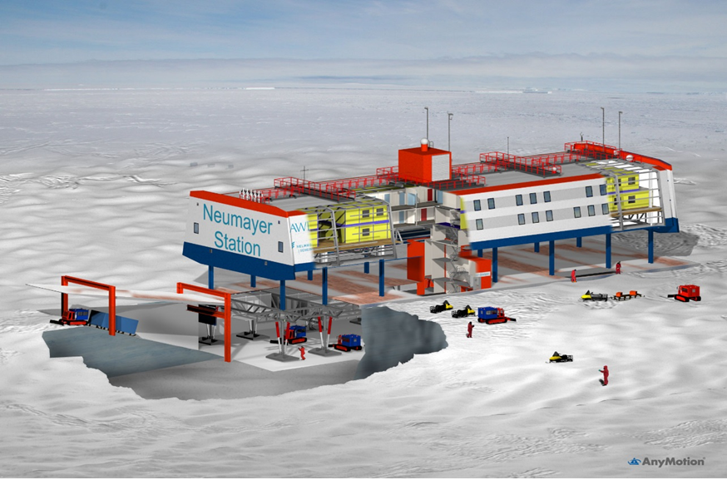
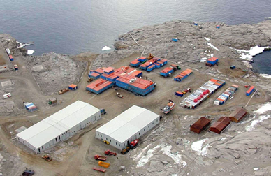
EUROPEAN POLAR INFRASTRUCTURE AND NETWORKS
European Polar Research Stations are a unique tool to Support Climate and Environmental Observations and monitoring in the Arctic and Antarctic Regions

Slide 27
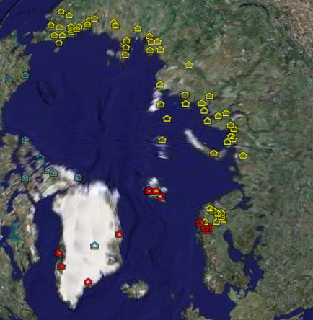
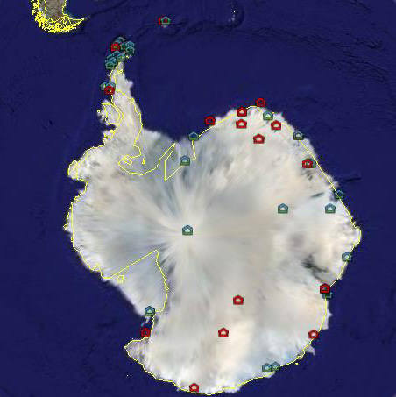



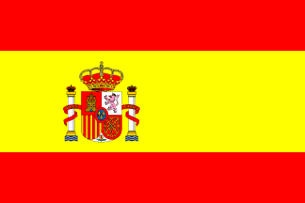



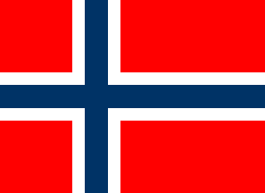
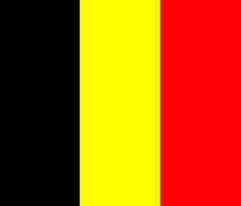




The European Polar Board scientific platform for European engagement in international science programmes

Slide 28
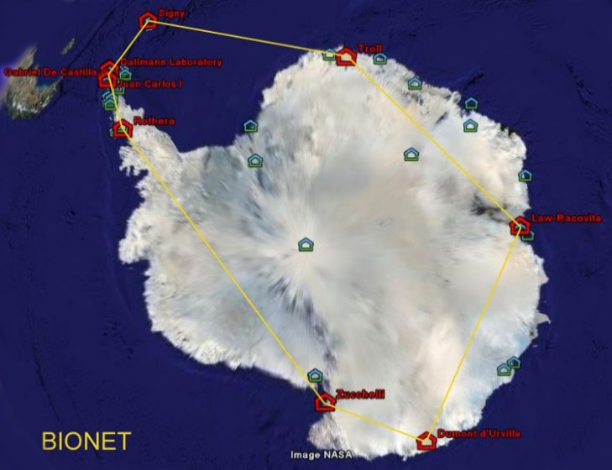
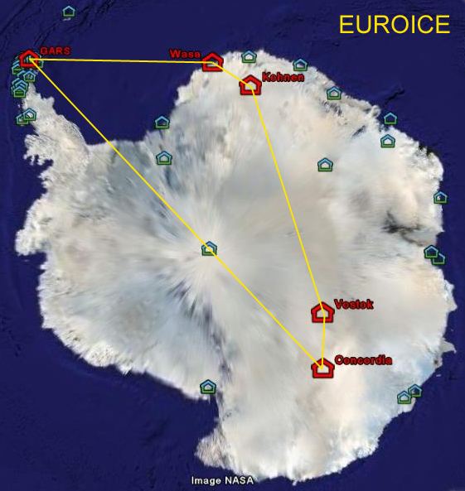
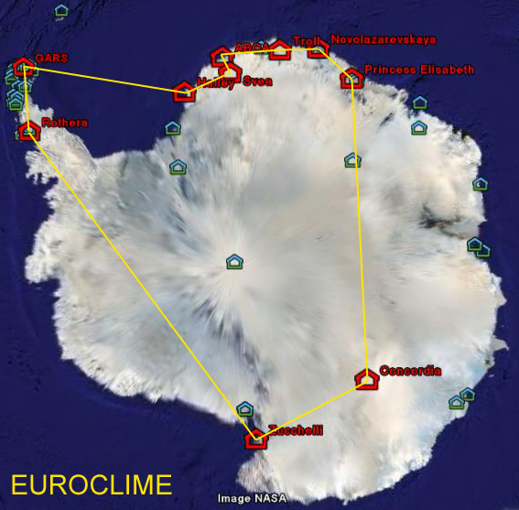
POTENTIAL ANTARCTIC SCIENTIFIC CLUSTERS
EPB FP7 proposal (2008), based on key scientific expertise of Antarctic stations
Climate change network
Biology network
ice network

Slide 29
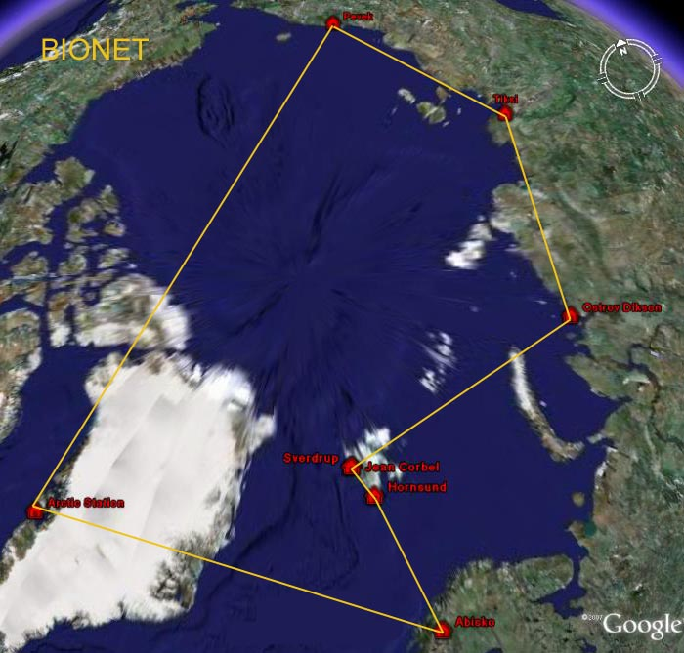
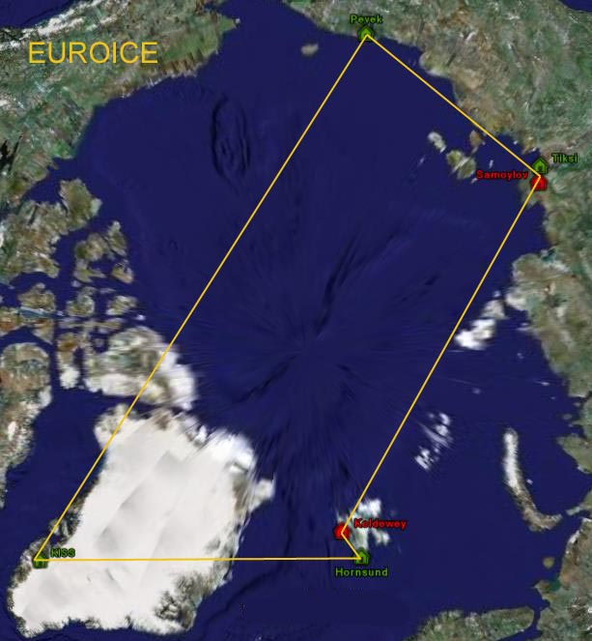
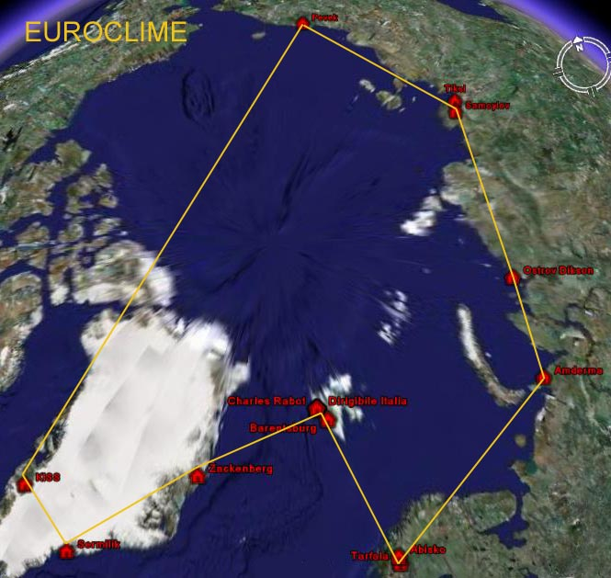
Biology network
POTENTIAL ARCTIC SCIENTIFIC CLUSTERS
EPB FP7 Proposal (2008), based on key scientific expertise of Arctic stations
Climate change network
ice network

Slide 30
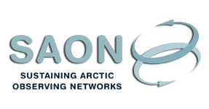
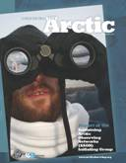
SUSTAINING ARCTIC OBSERVING NETWORK
The SAON approach is to build on existing observing sites,
systems and networks (SAON building blocks). SAON
is a means for addressing issues that transcend individual
networks.
The SAON SG agreed in June 2009 on four priority areas:
Inventory (survey) of existing networks
Data access and sharing
Community-based monitoring
Multinational collaboration among funding and implementing agencies
14 Networks, 11 Projects, Organizations (IASC, AMAP, WMO)
www.arcticobserving.org
The SAON report 'Observing the Arctic' was presented at the Arctic Council Ministerial Meeting in Tromsø April 2009.

Slide 31
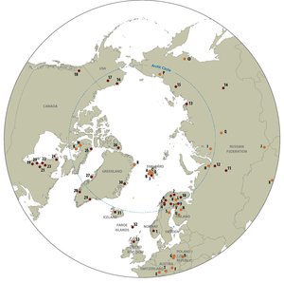

International Network for Terrestrial Research and Monitoring in the Arctic
INTERACT is a circumarctic network of currently 71 terrestrial field bases in northern Europe, Russia, US, Canada, Greenland, Iceland, the Faroe Islands and Scotland as well as stations in northern alpine areas.
INTERACT specifically seeks to build capacity for research and monitoring in the European Arctic and beyond

Slide 32
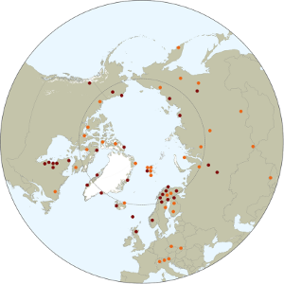

Slide 33
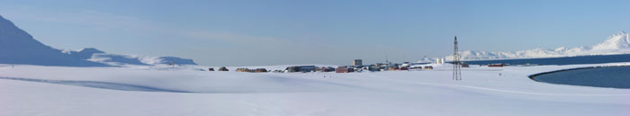
Svalbard Integrated Arctic Earth Observing System (SIOS)
Svalbard Integrated Earth Observing System (SIOS) is an international infrastructure project. There are 26 partners from Europe and Asia involved. The essential objective is to establish better coordinated services for the International Research community with respect to access, data and knowledge management, logistics and training.
SIOS will establish an upgraded and integral Earth Observing System based on already existing infrastructure, in order to better understand the ongoing and future climate changes. This means that the system, not only will study the single processes, but additionally look at the interaction of all levels between the five spheres biosphere, geosphere, atmosphere, cryosphere and hydrosphere

Slide 34
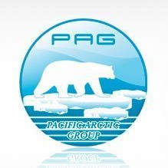
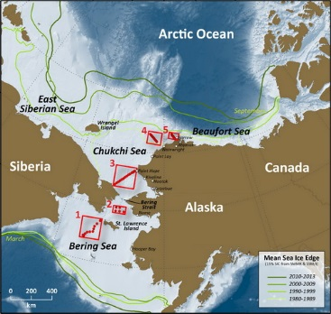
PACIFIC ARCTIC GROUP
The Pacific Arctic Group (PAG) is a group of institutes organized under the International Arctic Science Committee (IASC), having the mission to serve as a Pacific Arctic regional partnership to plan, coordinate, and collaborate on science activities on climate, contaminants, human dimensions and Arctic ecosystems.
Distributed Biological Observatory (DBO)
The “Distributed Biological Observatory (DBO)” is a change detection array along a latitudinal gradient extending from the northern Bering Sea to the Barrow Arc.
DBO is working to identification and consistent monitoring of biophysical responses
DBO stations lie along a regional "hotspot" transect lines located along a latitudinal gradient considered to exhibit high productivity, biodiversity, and overall rates of change
DBO stations are managed by national and international entities with shared data plan
DBO will also serve as a framework for international research coordination via the Arctic Council Circumpolar Biodiversity Monitoring Program (CBMP), and is recognized as a task of the pan-arctic Sustaining Arctic Observing Network (SAON) program

Slide 35

SCAR OBSERVING SYSTEM
Fast raising temperature in some Antarctic regions is contributing to disintegration of ice shelves and accelerating the retreat of glaciers. There is growing consensus that the Antarctic ice sheet is experiencing a net mass loss. Loss of ice from the West Antarctic ice sheet may possibly contribute to a rise in sea level by 2100 of up to 1.9 meters. The collapse of the East Antarctic sheet is an unlikely but not unrealistic event.
SCAR is supporting the following Group of Experts for Antarctic priority issues:
SOOS (Southern Ocean Observing System)
Ocean Acidification
ASPeCt (Antarctic Sea Ice Processes and Climate)
ISMASS (Ice Sheet Mass Balance and Sea Level)
Antarctic Biodiversity Informatics (ABI)
CPR (Continuous Plankton Recorder)

Slide 36


SOUTHERN OCEAN OBSERVING SYSTEM (SOOS)
The overall vision for SOOS is to design and implement a sustained, coherent, multidisciplinary observing system that provides the key data and data products required to address the key challenges identified.
Design and implement SO observing system
Advocate and guide development of new technologies
Unify current observation efforts and leverage further resources
Integrate / communicate – between nations, international and national projects, and across traditional disciplinary boundaries
Facilitate and develop a data system with seamless access to essential data and data products
SOOS is sponsored by SCAR and SCOR
Notes:
The overall vision for SOOS is to design and implement a sustained, coherent, multidisciplinary observing system that provides the key data and data products required to address the key challenges identified. It will evolve over time, as new technologies develop and automated techniques mature, and will be adaptable as new challenges come to the fore
First step in implementation is to design optimal sampling plans for each variable, and integrate these plans into an overall integrated sampling scheme.
Need quantitative targets for number and frequency of observations that are required.
Already defined for some elements (eg.,, repeat hydrography, Argo). others further work is needed, and will work through Framework for Ocean Observing steps of readiness. this process clarifies what is needed to move towards a sustainable observations network at the systems level.

Slide 37

The SOOS International Strategy for Observing Under Ice
The international community have worked together to produce a Strategy for sustained observations of the Antarctic sea-ice zone. The strategy includes observations needed for the study of interactions between the atmosphere, ocean and both sea ice and glacial ice.

Slide 38
ANTARCTIC NEAR-SHORE AND TERRESTRIAL
OBSERVING SYSTEM (ANTOS)
ANTOS DRAFT Objectives
Coordinate and expand strategic observations of Antarctic and subantarctic near-shore and terrestrial ecosystems to identify, track and attribute environmental change.
Stimulate the development of new observation technologies.
Provide opportunity for alignment of national and international programs and projects.
Provide an observational platform for SCAR Life Sciences programs

Slide 39
WORLD METEOROLOGICAL ORGANIZATION
WMO is moving ahead on the Global Cryosphere Watch (GCW), the Antarctic Observing Networks (AntON), and Global Integrated Polar Prediction System (GIPPS).
GCW is an international mechanism for supporting all key cryospheric in-situ and remote sensing observations. The observing component of GCW is a component of the WMO Integrated Global Observing System (WIGOS). Through WIGOS GCW will provide a contribution to GEOSS.
AntON: includes stations currently contributing to synoptic, climate or upper-air synoptic observations in the Global Telecommunication System (GTS), Global Climate Observing System (GCOS) or as Global Atmospheric Watch stations.
GIPPS: addresses key processes and interactions in Polar Regions such as stable boundary layers, polar clouds and precipitation, sea ice/ocean dynamics, hydrology, permafrost, ice sheet dynamics. Sustaining in-situ and satellite observations in Polar Regions, including reference observations. Products and services for Polar Regions and its components: Polar Prediction Project (PPP) of the World Weather Research Programme (WWRP) and Polar Climate Predictability Initiative (PCPI) of WCRP.

Slide 40


Courtesy David Hik, 2009

Slide 41



APPROACHING THE CONCLUSION
Last glacial max
To day
Next future ?

Slide 42
APPROACHING THE CONCLUSION
Deep Changes are affecting the Polar Regions much faster than other regions. They can have widespread effects on environment and socio-economic activities on hemisphere scale
Fast environmental changes could affect the human society at a rate that could not be properly recovered. However, they may also create new opportunities for societal development that must be managed properly.
Understanding and predicting changes is crucial for managing appropriate mitigation measures

Slide 43
APPROACHING THE CONCLUSION
Polar regions show us in advance and with a greater clearness the climate changes happening in our Planet.
Several authoritative Arctic and Antarctic Organizations, representing wide sectors of science are working to provide scientific priorities and guidelines. The IASC ICARP III and the SCAR Horizon Scan initiatives must be mentioned in this framework. However, these Organizations mainly focus on Regional issues.
A huge asset of well equipped scientific infrastructure and technologies to face Polar issues is already available along with a top-level scientific community.

Slide 44
APPROACHING THE CONCLUSION
However, despite the increasing number of international networks and programs, many observations are still carried out at a national or regional scale. A rather high rate of fragmentation, duplication of efforts, not optimized use of infrastructures, scarcely coordinated national agendas and plans must still be faced .
In order to improve the efficiency of the system, a common effort to strengthen cooperation supported by coordination, sharing infrastructure and data is needed.
GEO should take into consideration the Polar Regions because of their vulnerability to changes and, at the same time, their crucial contribution to shape the Earth Climate and its changes.

Slide 45
APPROACHING THE CONCLUSION
GEOSS may play a crucial role in integrating Polar observations at Regional and global scale and streamlining data sharing, interoperability and quality control.
In close contact with Polar Organizations and Programs and Stakeholders GEOSS may help:
Prioritize observation targets (EVs)
Avoid fragmentation/duplication
Facilitate International Cooperation
Data Policy and Quality control

Slide 46

Thank you for your attention
The Poles
The heart of the Earth
Notes:
46

Slide 47
Key parameters to be monitored
Sea and continental ice loss (surface, thickness, volume, ice-age)
Inflow of Atlantic waters in Arctic Basins
Changes in Permafrost active layer
Carbon/methane fluxes from land and sea
Human Population and living resources dynamics
Modification of regional/local habitat and environmental conditions
Frequency and distributions of extreme events

